Slide 1
Youth Leadership and Engagement within Clubs and Leagues
Manchester FA Young Leaders Academy

Slide 2
Agenda
Who are we?
Youth Leadership
Case study
Youth Voice and Volunteering
Support available
Q+A
Mythbusting
Youth Forums
Top tips

Slide 3
Who are we?

Slide 4
Youth Leadership
Young people aren’t just the leaders of tomorrow. They have the energy, skills and ideas to change football and the wider community for the better today. The FA wants to establish a culture of involving young people (16-25 years) in the organisation of football.
This approach will benefit young people, promote better informed and more representative decision making, and bring through a new generation of volunteers into the workforce across the grassroots game. For this approach to work it needs to be based on genuine youth-adult partnerships.
Notes:
One sentence – this is why it is necessary right now – at the start – highlight how imperative it is. - 70% of grassroots football – vital to the future of the game

Slide 5
The FA Youth Leadership Programme
The FA National Youth Council
FA Leadership Academy
FA Mentoring Scheme for Youth Leaders
The FA Regional Youth Network
FA Youth Leader Community
Clubs and Leagues
County FA Youth Councils
Partner organisations (e.g., Kick It Out, BUCS, Football v Homophobia, AOC, Youth Sport Trust)

Slide 6
Case Study – OAFC Girls & Women

Slide 7
Roger Hart’s Ladder of Participation

Slide 8
Youth Voice & Volunteering
Open forums
Youth forums and councils
Youth representation on the committee
Coaching
Questionnaires, comment boxes and surveys
Social/Written Media

Slide 9
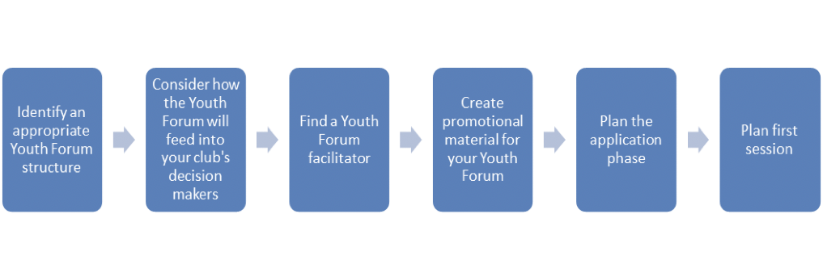
Youth Forums

Slide 10
Top tips to involve young people
Start by looking around you
Be truthful and honest about your offer
Remove barriers
Pat on the back
Be proud of what you're doing
Don’t let concerns about policy deter you
Take the time to train young people
Try before you buy
Smart recruitment
Would you do it?

Slide 11
Myth-busting
“Everyone is already overworked!”
“What qualifications are needed? Does it have to be the welfare officer?”
“It will cost money to facilitate”
“They might only be involved for a short time before going off to uni”
”It’s too time-consuming”
“Young people don’t have any experience in running a club or league”
“They will try to take over”

Slide 12
Support available
Football Development Officer (Clubs and Leagues) – sarah.cummings@manchesterfa.com
Young Leaders Academy – holly.grimes@oact.org.uk

Slide 13
Questions?

